Slide 1
A k-Nearest Neighbor Based Algorithm for Multi-label Classification
Min-Ling Zhang Zhi-Hua Zhou
National Laboratory for Novel Software Technology,
Nanjing University, Nanjing 210093, China
Presentation：Chen Ning
Supervisor：Shen-Huan Lyu
Date: 5/3/2024

Slide 2
Table of Contents
1
Introduction
2
Related Work
3
Proposed Method
4
Experiments
5
Conclusion

Slide 3
Introduction
An intuitive approach to solve multi-label problem is to decompose it into multiple independent binary classification problems. But this kind of method ignores the correlations between the different labels of each instance. Fortunately, some special algorithms are proposed, such as multi-label text categorization algorithms, multi-label decision trees and multi-label kernel method.
However, multi-label lazy learning approach is still not available. The paper use k-nearest neighbor(KNN) algorithm to solve it.

Slide 4
Table of Contents
1
Introduction
2
Related Work
3
Proposed Method
4
Experiments
5
Conclusion

Slide 5
Multi-Label Learning
BoosTexter
In the training phase, BoosTexter maintains a set of weights over both training examples and their labels, where training examples and their corresponding labels that are hard (easy) to predict correctly
get incrementally higher (lower) weights. Following the work of BoosTexter, multi-label learning has attracted many attentions from machine learning researchers.
Bayesian approach
A mixture probabilistic model is assumed to generate each document and EM algorithm is utilized to learn the mixture weights and the word distributions in each mixture component.
Kernel method
Defining a special cost function based on Ranking Loss and the corresponding margin for multi-label models.

Slide 6
Table of Contents
1
Introduction
2
Related Work
3
Proposed Method
4
Experiments
5
Conclusion

Slide 7
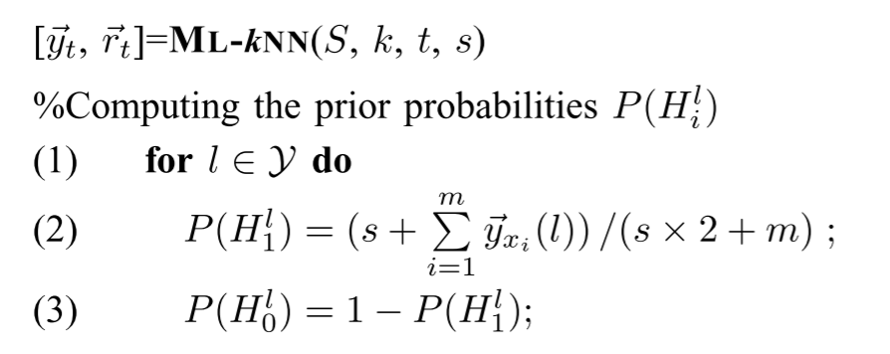
Proposed Method
Although there have been several learning algorithms specially designed for multi-label learning, developing lazy learning approach for multi-label problems is still an unsolved issue.
This paper propose a method ML-kNN to solve that question.

Slide 8
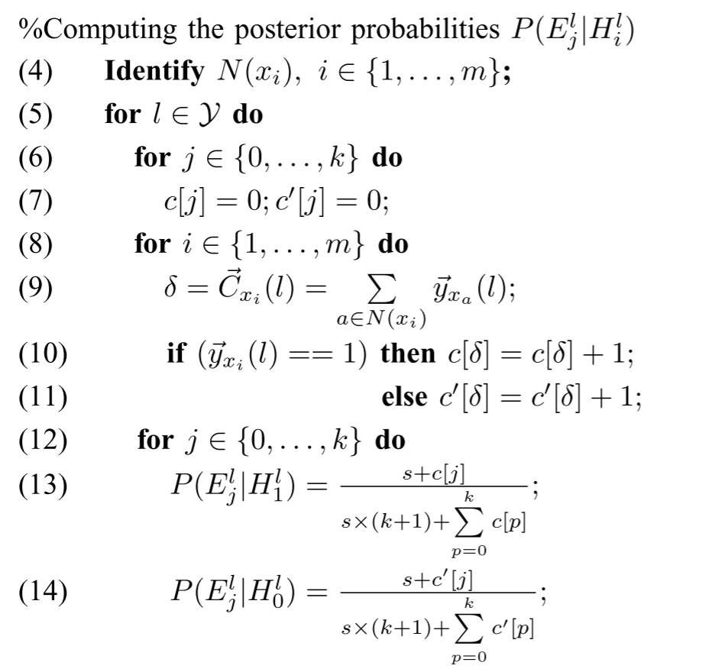
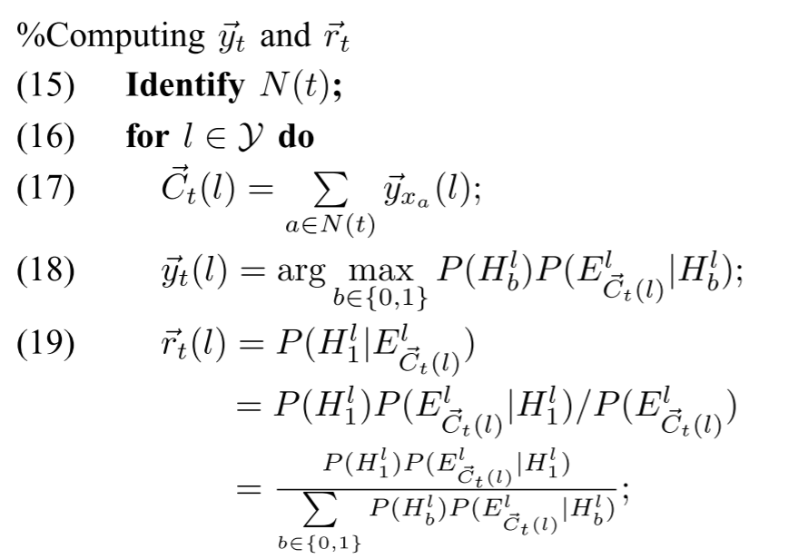
Proposed Method

Slide 9
Table of Contents
1
Introduction
2
Related Work
3
Proposed Method
4
Experiments
5
Conclusion

Slide 10
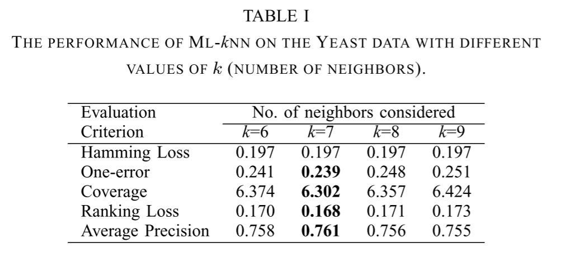
Experiments

Slide 11
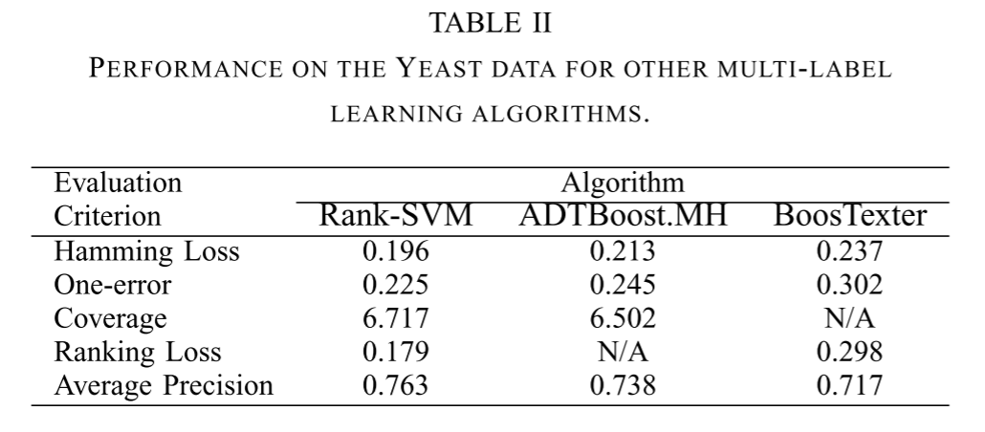
Experiments

Slide 12
Conclusion
Although k-nearest neighbors(KNN) can solve the questions of lazy learning of multi-label learning, it now seems not necessary and also is limited by the KNN algorithm.

